Slide 1
Graphs
Chapter 8

Slide 2
Objectives
Graphs
Graph Representation
Graph Traversals
Connectivity
Cycle Detection
Shortest Paths
Dijsktra algorithm
Floyd algorithm
Bellman-Ford algorithm
Spanning Trees
Kruskal algorithm
Dijktra algorithm
Eulerian and Hamiltonian Graphs
Graph coloring
Reading at home
Notes:
Note: (*) Means that students are required to understand essential features only (the problem explanation, definitions, the outline of algorithms…), not in details.

Slide 3
Graph definition
A graph is a pair (V, E), where
V is a set of nodes, called vertices
E is a collection of pairs of vertices, called edges
In brief, a graph is collection of vertices and the connections between them.
Example
Vertex represents an airport and stores the tree-letter airport code
Edge represents a flight route between two airports and stores the mileage of the route

Slide 4
Terminologies
An undirected graph: A graph G=(V, E) is called undirected graph if each edge e being a set of two vertices from V(e={u, v})
A directed graph, or diagraph: A G=(V, E) is called directed graph if each edge e is an ordered pair of vertices from V (e=(u, v)).
1
1
5
5
3
3
4
2
4
2
Undirected Graph
Directed Graph

Slide 5
Terminologies
A weighted graph: A G=(V, E) is called weighted graph if each edge e has an assigned number, called the weight of the edge e.
1
3
1
5
3
3
2
1
4
2
Weighted Graph

Slide 6
Terminologies
A multiple and single edges: Multiple edges are two or more edges connecting the same two vertices
Note that in directed graph the pair (u, v) is not the same as the pair (v, u)
1
5
3
4
2
Directed Graph
with multiple edges
1
1
1
5
5
5
3
3
3
4
2
4
2
4
2
Undirected Graph
with multiple edges
Single
Directed Graph
Single
Undirected Graph

Slide 7
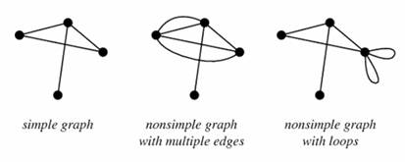
Terminologies
A graph loops: A degenerate edge of a graph which joins a vertex to itself, also called a self-loop
A simple graph: A simple graph, also called a strict graph, is an unweighted, undirected graph containing no graph loops or multiple edges. Unless stated otherwise, the unqualified term “graph” usually refers to a simple graph

Slide 8
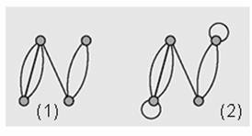
Terminologies
A multigraph is a graph in which two vertices (with the condition v_{i} different from v_{j} can be joined by multiple edges (1)
If we remove the condition v_{i} different from v_{j} in the definition of a multigraph then we get the notion of a pseudograph, which allows for loops to occur (2)

Slide 9
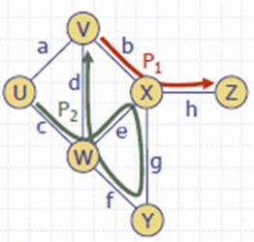
Terminologies
Path from v1 to vn is a sequence of edges (v₁, v₂), (v₂, v₃), …, (v_{n-1}, v_{n}).
If v₁ = v_{n} and no edge is repeated, then the path is called a circuit.
If all vertices in a circuit are different, then it is called a cycle.

Slide 10
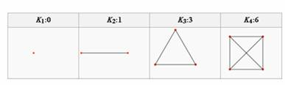
Terminologies
A complete graph is a graph where every pair of vertices is connected by an edge
A simple complete graph on n vertices has n vertices and n(n-1)/2 edges, and is denoted by Kn

Slide 11
Terminologies
A graph G’=(V’, E’) is a subgraph of another graph G=(V,E) iff
Two vertices u and v are called adjacent if the edge (u, v) is in E. Such an edge called incident with the vertices u and v.
The degree of a vertex u, deg(u), is the number of edges incident with u.
If deg(u)=0, then u is called isolated vertex.

Slide 12
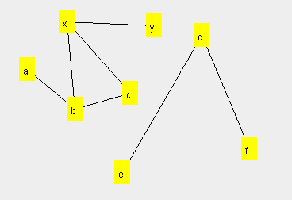
Henry: graphs and trees
A tree is a directed graph with only one connected component
A graph can be sliced into many trees starting from one node
Root a
Root x
Root d

Slide 13
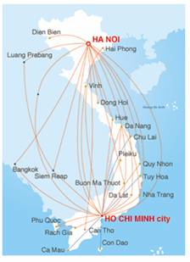

Graph applications
Electronic circuits
Transportation networks
Computer networks
Database
Entity-relationship diagram
Graphical models

Slide 14
Graph representation

Slide 15
Adjacency list representation
Specifies all vertices adjacent to each vertex of the graph
This list can be represented as a table (picture b, next slide)
Called star representation
Can be forward or reverse
This list can be represented as linked list (picture c, next slide)

Slide 16
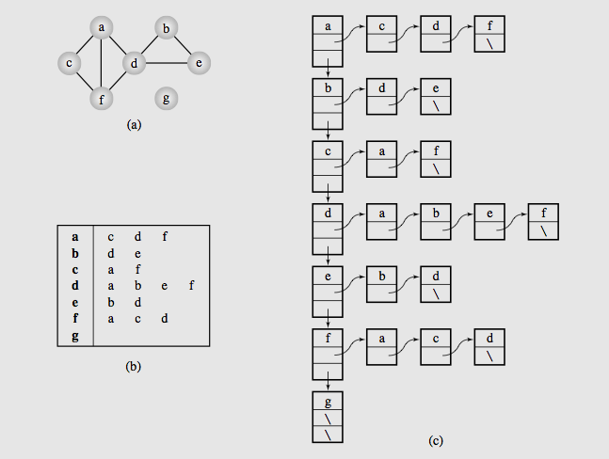
Adjacency list representation

Slide 17

Adjacency Matrix
It has two forms
Adjacency matrix and
Incidence matrix
G=(V, E) is a binary |V|x|V| such that each entry of this matrix

Slide 18
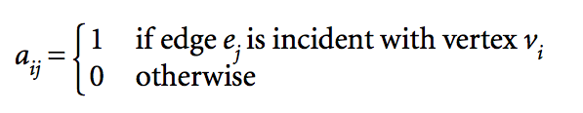
Adjacency Matrix
Incidence matrix of graph G=(V, E) is a |V|x|E| matrix such that

Slide 19
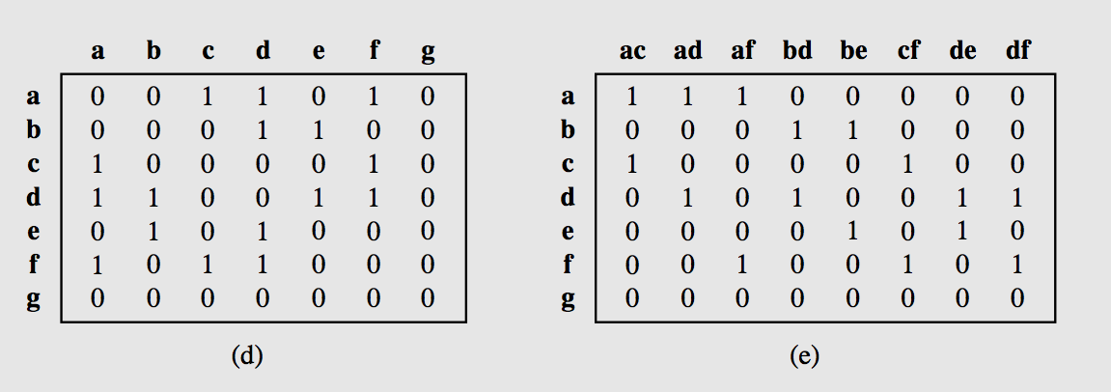
Adjacency Matrix Examples

Slide 20
Graph scanning
(graph traversal)

Slide 21
Breadth-first traversal
In the breadth-first search algorithm
Selected vertex v is visited and then each unvisited vertices adjacent to v is visited.
Suppose adjacent vertices are v1, v2, …, vk.
After all these are visited, then all those for v1 are visited then all those for v2 are visited and so on and so forth.
If there’s still unvisited vertices, the algorithm continues restarting for one of the unvisited ones.

Slide 22
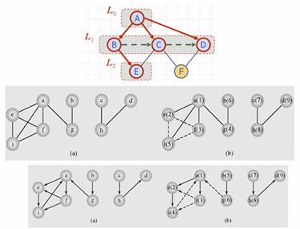
Breadth-first traversal

Slide 23
Breadth-first algorithm
BFS(Graph G)
{
all vertices of G are first painted white
graph root is painted grey and put in a queue
while the queue is not empty{
a vertex u is removed from the queue
for all white successors v of u{
v is painted grey
v is added to the queue
}
u is painted black
}
}

Slide 24
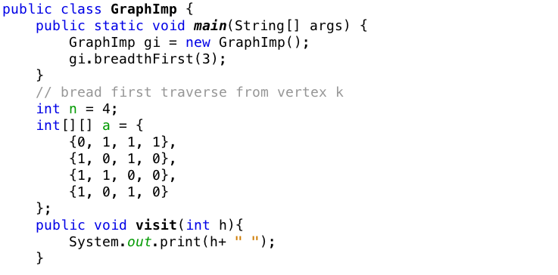
Breadth-first algorithm

Slide 25
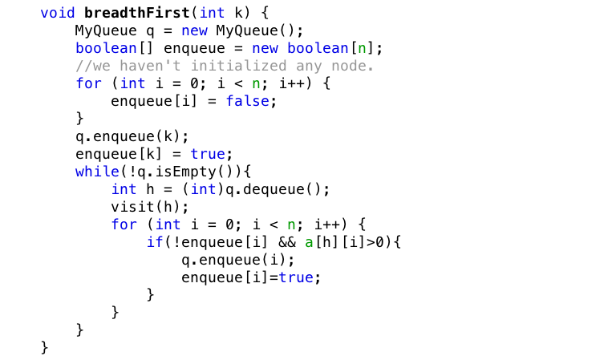
Breadth first algorithm

Slide 26
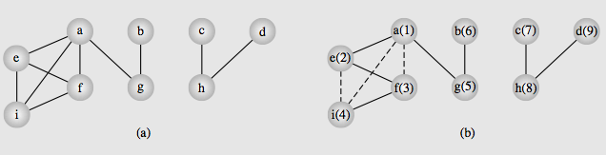
Depth first traversal
First selected vertex v is visited and then each unvisited vertex adjacent to v is visited by depth-first search.
If there are still some unvisited vertices in the graph
The traversal continues restarting for one of the unvisited vertices.

Slide 27
Depth-first traversal algorithm
DFS-visit (Graph G, Vertex u)
{
the vertex u is painted gray
for all white successors v of u
{
dfs-visit(G, v)
}
u is painted black
}
DFS (Graph G)
{
all vertices of G are first painted white
DFS-visit(G, root of G)
}

Slide 28
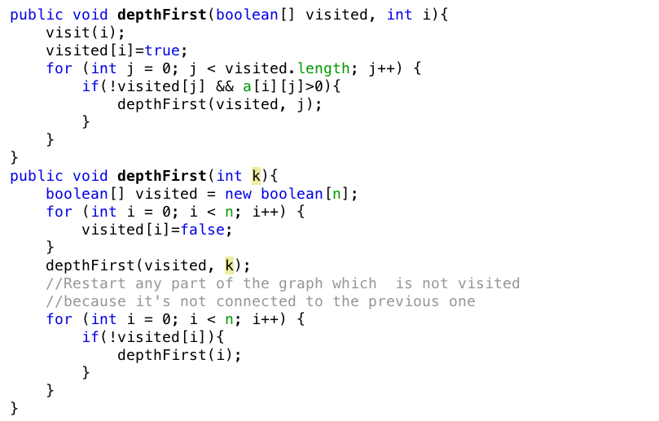
Depth-first traversal algorithm

Slide 29
Connectivity
Connected components

Slide 30
Connectivity
An undirected graph is called connected when there is a path between any two vertices
A graph is called n-connected if there are at least n different paths between any two vertices
There are n paths between any two vertices
The paths have no vertices in common
N=2 is called 2-connected or biconnected graph
Directed graph is called weakly connected if replacing all of its directed edges with undirected edges produces a connected (undirected) graph.
It is connected if it contains directed path from u to v or a directed path from v to u for every pair of vertices u, v.

Slide 31
Connectivity
It is strongly connected or strong if it contains directed path from u to v and a directed path from v to u for every pair of vertices u, v.
The strong components are the maximal strongly connected subgraphs.
If a vertex is removed from a graph (also its edges)
The graph is split into two separate subgraphs.
This point is called articulation point, or cut-vertex
If an edge causes a graph to be split into two subgraphs, it is called bridge or cut-edge.
Connected subgraphs with no articulation points or bridges are called blocks.
We can use depth first traverse to check the connectivity of a graph

Slide 32
Cycle detection
inintialize num[v] to 0 for all v
initialize edgeSet to the empty set
cycleDetectionDFS(u)
num[u] = i++;
for all vertices v adjacent to u
if num[v]==0
add edge (u, v) to edgeSet
cycleDetectionDFS(u)
else if edge(u, v) is in edges
cycle detected

Slide 33
Shortest path finding

Slide 34
Shortest path problem
The problem: find the shortest path between a pair of vertices of a graph
The graph: may contain negative edges but no negative cycles
A representation: a weighted matrix where
W(i,j)=0 if i=j
W(i, j)=infinity if there’s no edge between j and j
W(i, j)=weight of the edge (i, j)

Slide 35
Shortest Path Methods
The methods of solving the shortest path problem are divided into two classes
Label-setting methods
Each pass through the vertices still to be processed, one vertex is set to a value that remains unchanged to the end of the execution
Label-correcting methods
Allow for the changing of any label during application of the method
Most of the label-setting and label-correcting methods, however, can be subsumed to the same form, which allows finding shortest paths from one vertex to all other vertices.

Slide 36
Dijkstra's
shortest path

Slide 37
Dijkstra’s algorithm
Dijkstra’s algorithm keeps two sets of vertices
S: Vertices whose shortest paths have already been determined
V-S: Remainder
d: Best estimates of shortest path to each vertex
p: Predecessors for each vertex

Slide 38
Dijkstra algorithm
DijkstraAlgorithm(non-negative weighted simple digraph, vertex first){
currDist(first) = 0;
for all vertices v != first currDist(v) = infinity
toBeChecked = V(all vertices);
checked = empty;
while toBeChecked is not empty{
u = a vertex in toBeChecked with min.currDist(u);
remove u from toBeChecked and add to checked;
for all vertices v adjacent to u and in toBechecked
if(currDist(v) > currDist(u) + weight(edge(u,v))){
currDist(v) = currDist(u) + weight(edge(uv))
predecessor(v)=u;
}
}
}

Slide 39
Henry: keeping the active head
The root is the seed node
The active head set is the set of active nodes to be developed next
We only develop the smallest one
After having completed the graph, we will have many paths (list of paths) with the optimal ones
Listing the paths

Slide 40
Dijkstra algorithm example
[?, inf]
[?, inf]
[1, 14]
[6, 20]
[3, 11]
9
5
[4, 26]
6
[?, inf]
2
[1, 9]
[?, inf]
[2, 17]
6
[2, 22]
14
[3, 20]
3
11
4
9
1
10
MyNodeTag
+ parentNod
+ distanceFromPar
7
15
[1, 0]
2
[?, inf]
[1, 7]
Always take the unchecked node with minimum distance so far to check next.

Slide 41
Floyd's
shortest path

Slide 42
Floyd Algorithm
The problem: find the shortest path between every pair of vertices of a graph
The graph: may contain negative edges but no negative cycles

Slide 43
Floyd Algorithm
D=W //initialize D array to W[]
For i=1 to n
for j=1 to n
P=i //initialize P array to [i]
for k = 1 to n
do for i = 1 to n
do for j=1 to n
if(D[i,j] > D[i,k]+D[k,j]){
D[i,j]=D[i, k]+D[k, j];
P[i, j]=P[k, j];
}

Slide 44
Floyd Algorithm Example
1
5
1
2
3
1
k=1 to 6
5
7
6
4
i=1
6
3
50
1
 | 1 | 2 | 3 | 4 | 5 | 6
1 | [0,1] | [5,1] | [inf,1] | [7, 1] | [3,1] | [1,1]
2 | [5,2] | [0,2] | [4,2] | [inf,2] | [inf,2] | [1,2]
3 | [inf,3] | [4,3] | [0,3] | [2,3] | [inf,3] | [1,3]
4 | [7,4] | [inf,4] | [2,4] | [0,4] | [3,4] | [50,4]
5 | [3,5] | [inf,5] | [inf,5] | [3,5] | [0,5] | [inf,5]
6 | [1,6] | [1,6] | [1,6] | [50,6] | [inf,6] | [0,6]
j=1
4
3
2
6

Slide 45
Floyd Algorithm Example
1
5
k=1
if(D[i,j] > D[i, 1] + D[1,j])
Then
D[i,j] = D[i,1] + D[j,1];
P[i,j] = P[1,j]
1
2
3
1
5
7
6
4
j=1
6
3
50
1
 | 1 | 2 | 3 | 4 | 5 | 6
1 | [0,1] | [5,1] | [inf,1] | [7, 1] | [3,1] | [1,1]
2 | [5,2] | [0,2] | [4,2] | [inf,2] | [inf,2] | [1,2]
3 | [inf,3] | [4,3] | [0,3] | [2,3] | [inf,3] | [1,3]
4 | [7,4] | [inf,4] | [2,4] | [0,4] | [3,4] | [50,4]
5 | [3,5] | [inf,5] | [inf,5] | [3,5] | [0,5] | [inf,5]
6 | [1,6] | [1,6] | [1,6] | [50,6] | [inf,6] | [0,6]
i=1
4
3
2
[12,1]
[8,1]
[12,1]
[8,1]
[8,1]
[4,1]
6
[8,1]
[4,1]

Slide 46
Floyd Algorithm Example
1
5
k=2
if(D[i,j] > D[i, 2] + D[2,j])
Then
D[i,j] = D[i,2] + D[j,2];
P[i,j] = P[2,j]
1
2
3
1
5
7
6
4
i=1
6
3
50
1
 | 1 | 2 | 3 | 4 | 5 | 6
1 | [0,1] | [5,1] | [inf,1] | [7, 1] | [3,1] | [1,1]
2 | [5,2] | [0,2] | [4,2] | [inf,2] | [inf,2] | [1,2]
3 | [inf,3] | [4,3] | [0,3] | [2,3] | [inf,3] | [1,3]
4 | [7,4] | [inf,4] | [2,4] | [0,4] | [3,4] | [50,4]
5 | [3,5] | [inf,5] | [inf,5] | [3,5] | [0,5] | [inf,5]
6 | [1,6] | [1,6] | [1,6] | [50,6] | [inf,6] | [0,6]
j=1
[9,2]
4
3
2
[12,1]
[8,1]
[9,2]
[12,1]
[12,1]
[8,1]
[8,1]
[12,2]
[4,1]
6
[8,1]
[4,1]
So on and so forth…

Slide 47
The test of shortest path
The line/chain: the distance is 1 for all
The tree
The flow
1
2
3
4
2
3
1
2
3
4
1
5
9
5
4
6
1
2
3
4
7
6
5
6

Slide 48
More tests on chains
1-2-4-6
1-2-3-5-6
1
2
3
4
5
6
1
2
3
4
5
6
1-2-5-6
1-2-3-4-6

Slide 49
Circular cases
2
3
1
4
6
5

Slide 50
Summaries
Graphs
Graph Representation
Graph Traversals
Connectivity
Cycle Detection
Shortest Paths
Dijsktra algorithm
Floyd algorithm
Bellman-Ford algorithm
Spanning Trees
Kruskal algorithm
Dijktra algorithm
Eulerian and Hamiltonian Graphs
Graph coloring
Reading at home
Notes:
Note: (*) Means that students are required to understand essential features only (the problem explanation, definitions, the outline of algorithms…), not in details.

